Slide 1

Biodiversity in National Parks
Analyzing Species Conservation Status Across Four Parks
(Portfolio Project)
Jacob Lindström

Slide 2
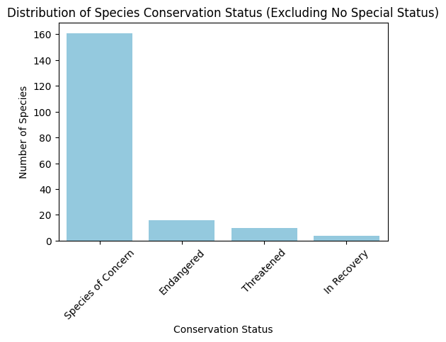
Dataset Overview: species_info.csv
Dataset Description:
Contains information about various species, including their scientific names, categories, and conservation status.
Missing conservation status values were filled with 'No Special Status' to ensure completeness.
Key Observations:
Majority of species have 'No Special Status'.
Categories include Mammals, Birds, Reptiles, Amphibians, etc.
Conservation status types include 'Endangered', 'Threatened', and 'Species of Concern'.
Note: Since The overwhelming majority of values was ”No Special Status”, the graph only shows the distribution of species that are at risk.

Slide 3
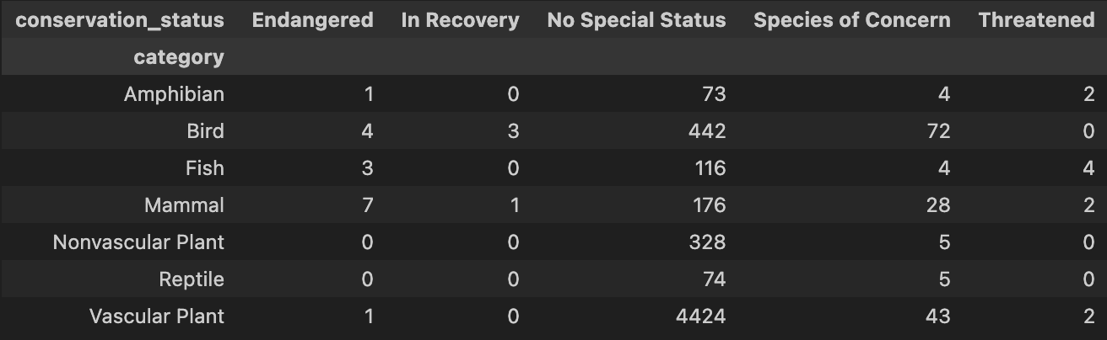
Significance Testing for Conservation Status
Purpose: To determine if certain categories of species are more likely to be endangered.
Method:
Chi-Square Test of Independence applied to compare species categories and their conservation status.
Null Hypothesis: There is no relationship between species category and conservation status.
Alternative Hypothesis: There is a significant relationship between species category and conservation status.
Result:
p-value << 0.05, indicating a strong relationship between species category and conservation status.
contingency table:

Slide 4

Recommendations for Conservationists
Based on Findings:
Species categories with higher proportions of endangered species should be prioritized for conservation efforts.
Specific attention should be given to species categories that showed the strongest correlation with endangered status.
Additional studies should be conducted to monitor changes over time and develop targeted conservation plans.

Slide 5
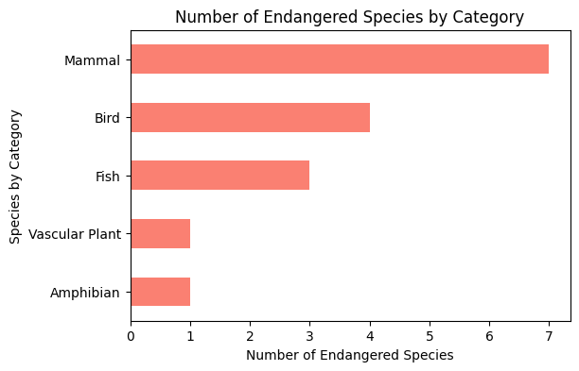
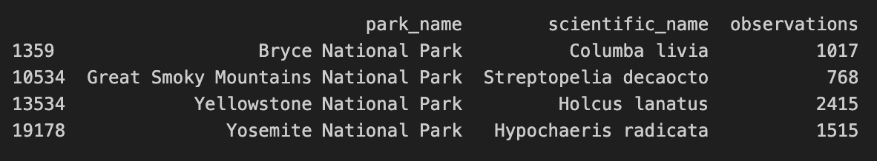
Additional Graphics
Graphs Included:
Distribution of Species Conservation Status (Excluding No Special Status).
Number of Endangered Species by Category.
Table of Most Spotted Species at Each Park.
Visual Representation:
Providing insight into the spread and severity of conservation concerns across parks.

